Slide 1

MOVIE SEARCH APP
Bachelor of Technology
In
Information Technology
By
V. HARSHITHA 22R21A1259

Slide 2
Contents
Introduction
Problem Statement
Objective
Features
Tech Stack Used
Project Structure
Challenges Faced
Use Cases
Scope of the Project
Conclusion
Screenshots
References

Slide 3
Introduction
The Movie Search App is a web-based application developed using front-end web technologies: HTML, CSS, and JavaScript. The app leverages the OMDb API (Open Movie Database) to allow users to search for movies by name and view essential details like poster, title, release year, and type (movie, series, etc.). It provides a practical example of integrating external APIs into a frontend application while offering a clean and responsive user interface.

Slide 4
Problem Statement
In today's digital age, users often want quick access to movie information without visiting multiple platforms. Many applications providing such services are heavy, complex, or require sign-in. This project aims to demonstrate a lightweight, no-login, fast-access movie search utility, which:
Focuses only on what the user needs — title, year, poster, and type.
Demonstrates frontend skills like API fetching, DOM manipulation, and responsive design.
Provides a minimal yet expandable base for future app development.

Slide 5
Objective
Build a single-page web app with a clean UI/UX.
Implement live movie search functionality using a third-party REST API.
Enhance frontend skills through real-time user interaction handling.
Practice error handling and improve user feedback when searches fail.
Lay the foundation for potential full-stack expansion.

Slide 6
Features
Search Functionality: Enter any movie/series title to fetch results.
Poster & Info Display: Each result shows an image, title, year, and media type.
Error Handling: Displays friendly messages for no results or input errors.
Responsive Design: Works smoothly on both desktop and mobile browsers.
Interactive UI: Dynamically updates results without reloading the page.

Slide 7
Tech Stack Used
Technology | Role
HTML5 | Structure of the web page
CSS3 | Layout, styling, responsive design
JavaScript (ES6) | API call logic, event handling, DOM manipulation
OMDb API | Source of real-time movie data

Slide 8
Project Structure
/movie-search-app
│
├── index.html ← Web page structure
├── style.css ← Styling for layout and movie cards
└── script.js ← Core logic: API fetch, dynamic rendering

Slide 9
Challenges Faced
API limits and key validation issues
Handling asynchronous data and errors smoothly
Preventing UI glitches for empty or failed searches
Ensuring mobile responsiveness with pure CSS

Slide 10
Use Cases
Learn JavaScript and API integration through a hands-on project
Practice DOM manipulation and dynamic UI rendering
Showcase in portfolio or frontend job interviews
Use as a base for a movie recommendation system
Add features like favorites, dark mode, or detailed view
Deploy on GitHub Pages or Netlify for hosting practice
Upgrade to frameworks like React for advanced learning
Collaborate on GitHub to learn version control and open-source workflow

Slide 11
Scope of the Project
The scope of the Movie Search App project is focused on building a lightweight, browser-based application that enables users to search for movies and view essential details such as title, year, type, and poster using the OMDb API. It provides a practical learning platform for frontend development concepts including HTML structure, CSS styling, JavaScript logic, and API integration. The project is scalable and can be enhanced with additional features like full movie details, watchlist management, search filters, and pagination. It also offers opportunities for deployment, UI/UX improvements, and conversion into a framework-based application using tools like React

Slide 12
Conclusion
The Movie Search App is a simple yet effective frontend project that demonstrates key web development concepts such as HTML structure, CSS styling, JavaScript functionality, and third-party API integration. It allows users to search for movies in real-time and view basic information fetched from the OMDb API, providing a practical learning experience for handling asynchronous operations and dynamic content rendering. This project serves as a strong foundation for beginners to build more complex applications and can be expanded with features like detailed movie views, watchlists, and user authentication.

Slide 13
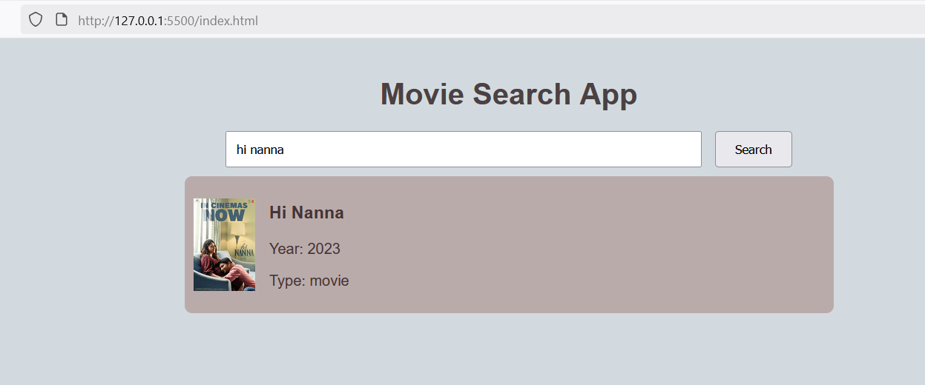
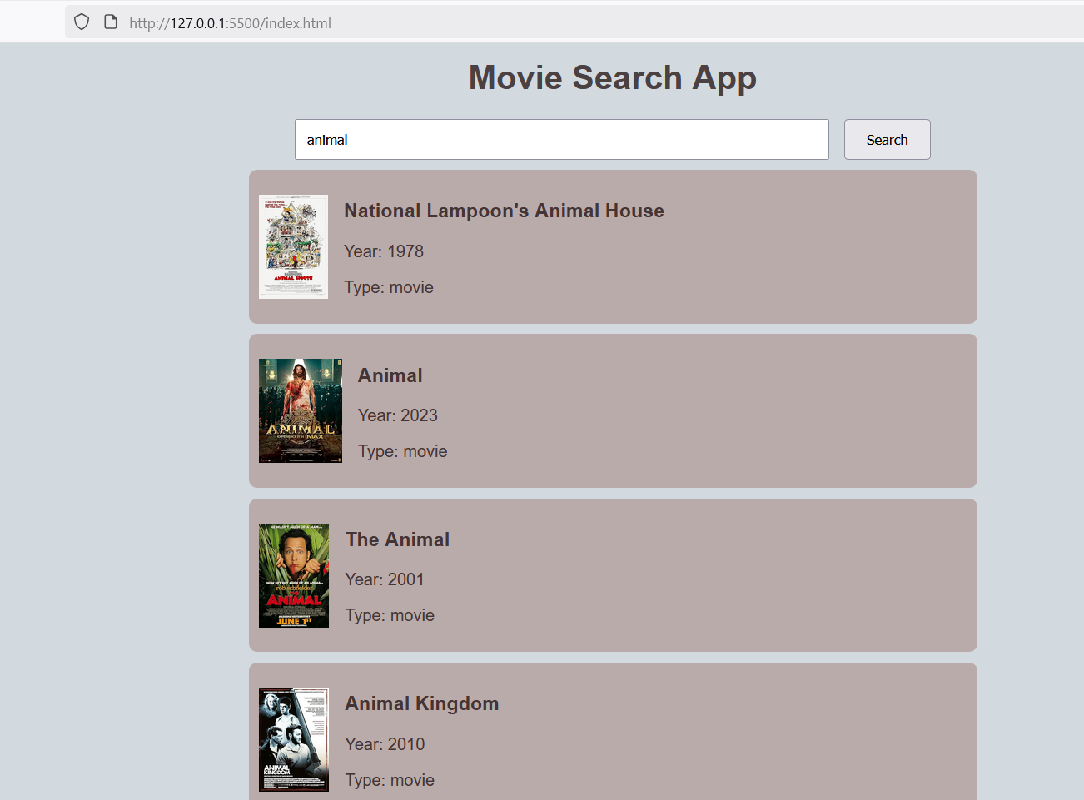
Screenshots
Fig 1: Results of searched product
Fig 2: Results of searched product

Slide 14
References
OMDb API Official Site https://www.omdbapi.com/ MDN Web Docs – JavaScript Fetch API https://developer.mozilla.org/en-US/docs/Web/API/Fetch_API W3Schools – JavaScript Tutorial https://www.w3schools.com/js/ W3Schools – HTML & CSS https://www.w3schools.com/html/ https://www.w3schools.com/css/
TMDb API (Alternative Movie API) https://developer.themoviedb.org/docs

Slide 15


